Slide 1
Aspirin

Slide 2
Aspirin
Mechanism of action
Aspirin in Primary Prevention
*ASPREE*
ASCEND
ARRIVE
Bleeding risks
Aspirin in Secondary Prevention

Slide 3
Aspirin Mechanism
Willow bark contains salicylates and was used for analgesia > 3500 years ago by the Sumerians and Egyptians.
Mechanism of action:
Irreversibly inhibits Cyclooxygenase (COX-1 and COX-2)
COX-1 leads to production of prostaglandins
protect gastric mucosa
maintain renal blood flow
regulate platelet activation and aggregation.
COX-2 expression is induced by inflammation
promotes the inflammatory response.
Blocking COX-1 and/or COX-2 leads to reduced production of prostaglandins and thromboxane
Reduced inflammation
Inhibition of platelet aggregation
Aspirin | Circulation (ahajournals.org)

Slide 4
Aspirin Mechanism
Plasma half-life of 20 minutes
Platelets have no nucleus and limited mRNA/protein synthesis
COX-1 inhibition in platelets is irreversible and lasts until the platelet is destroyed and replaced.
Platelet life ~10 days
May protect LDL from oxidation
Improves endothelial dysfunction in atherosclerotic vessels
Antioxidant effects
probably other effects that lead to reduced inflammatory response
Aspirin | Circulation (ahajournals.org)

Slide 5
Aspirin Mechanism
Rapidly absorbed in upper GI tract
inhibits platelet function within 60 minutes
Enteric coating significantly delays absorption
BUT, does not seem to reduce GI Bleeding risk
Risk of aspirin-associated major upper-gastrointestinal bleeding with enteric-coated or buffered product - PubMed (nih.gov)
Single 100mg dose stops Thromboxane synthesis
Effect of daily dosing is cumulative.
Higher doses not proven to be more effective for antiplatelet effects and increase GI side effects.
Aspirin | Circulation (ahajournals.org)

Slide 6
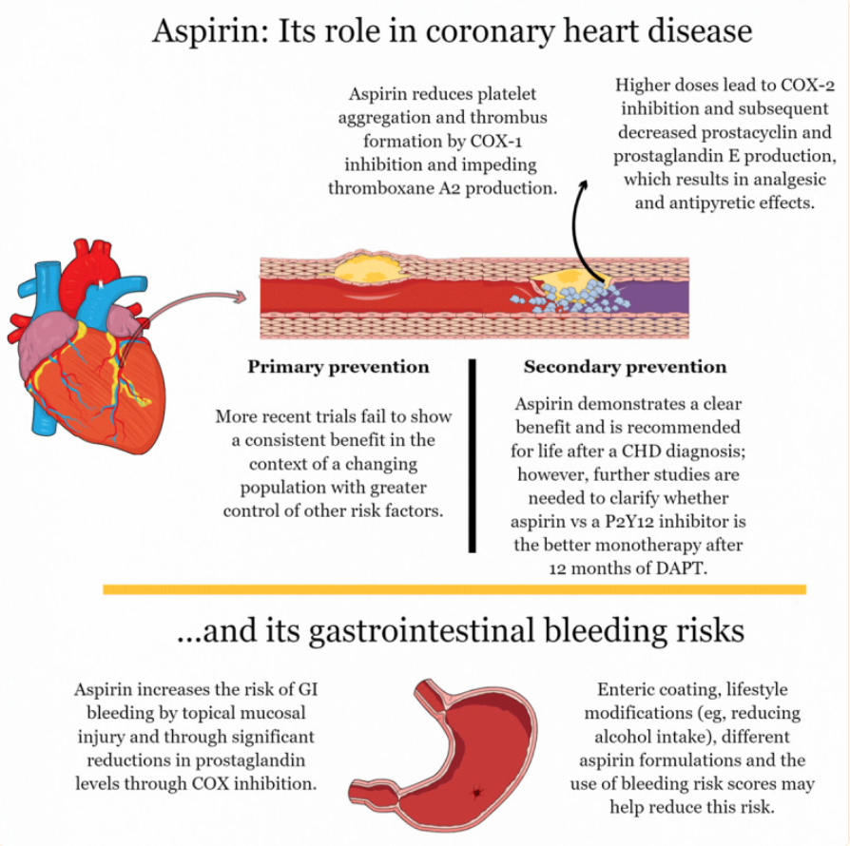
Aspirin in the Modern Era of Cardiovascular Disease Prevention - PMC (nih.gov)
Methodist Debakey Cardiovasc J. 2021; 17(4): 36–47.
Published online 2021 Sep 24. doi: 10.14797/mdcvj.293
The role of aspirin in primary and secondary prevention. COX: cyclooxygenase isoenzyme; CHD: coronary heart disease; P2Y12: a chemoreceptor for adenosine diphosphate; DAPT: dual antiplatelet therapy; GI: gastrointestinal.

Slide 7
Aspirin for CVD Primary Prevention

Slide 8
ASPREE Trial 2018 ASPirin in Reducing Events in the Elderly
Aspirin 100mg qd vs Placebo. n = 19,114; Median of 4.7 years of follow-up
Randomized, double-blind, placebo-controlled trial of daily low-dose aspirin (100 mg) in older adults in US and Australia.
Healthy individuals >70 y/o (or >65 y/o for blacks and Hispanics); avg age 74; female 56%; Diabetic 11%
Public Funding: United States and Australian governments and is led by the Berman Centre for Outcomes and Clinical Research in the U.S. and Monash University in Australia.
Exclusion criteria: cardiovascular or cerebrovascular disease, dementia, high bleeding risk
Primary Outcome: all-cause death, dementia, or physical disability
Secondary outcome: Hemorrhage, stroke, MI, hospitalization for heart failure, fatal CVD, cancer

Slide 9
ASPREE Results
Aspirin did not prolong disability-free survival
Primary outcomes (Events per 1000 person-years)
All-cause death, dementia, or physical disability
Aspirin did not prolong disability-free survival
12.7 aspirin vs 11.1 placebo
HR 1.14; 95% CI 1.01 - 1.29
Cancer contribution to death was higher in the aspirin group
HR 1.31, 95% CI 1.10-1.56
Secondary outcomes (Events per 1000 person-years)
CVD event: 10.7 aspirin vs 11.3 placebo (p = 0.79)
Major CV event: 7.8 aspirin vs 8.8 placebo (p=0.89)
Major hemorrhage: 8.6 aspirin vs 6.2 placebo (p <0.001)
Intracranial bleeding: 2.5 aspirin vs 1.7 placebo (p <0.05)
Upper GI bleed: 2.1 aspirin vs 1.1 placebo (p <0.05)

Slide 10
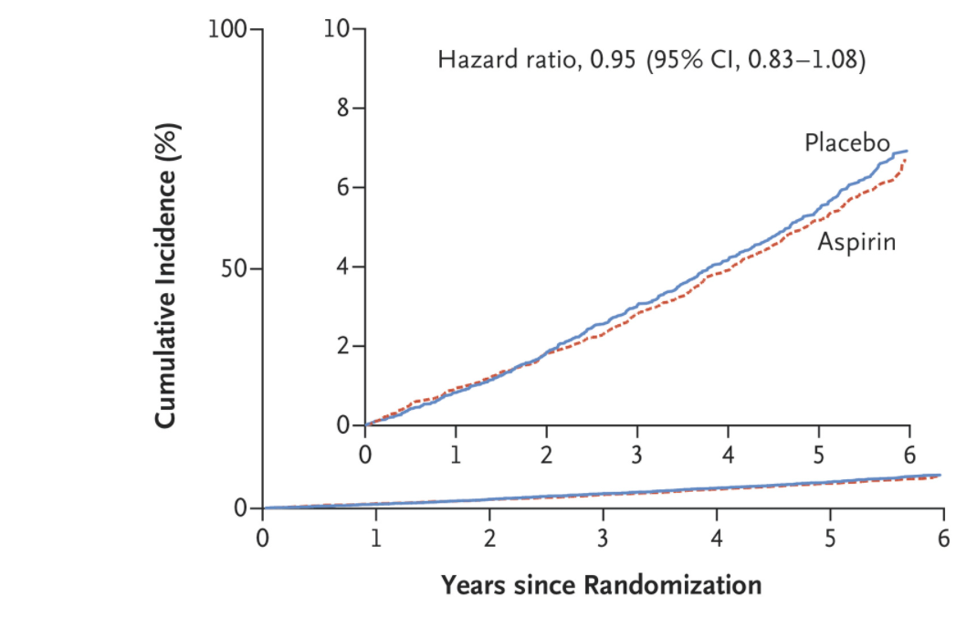
ASPREE Cumulative Incidence of Cardiovascular Disease

Slide 11
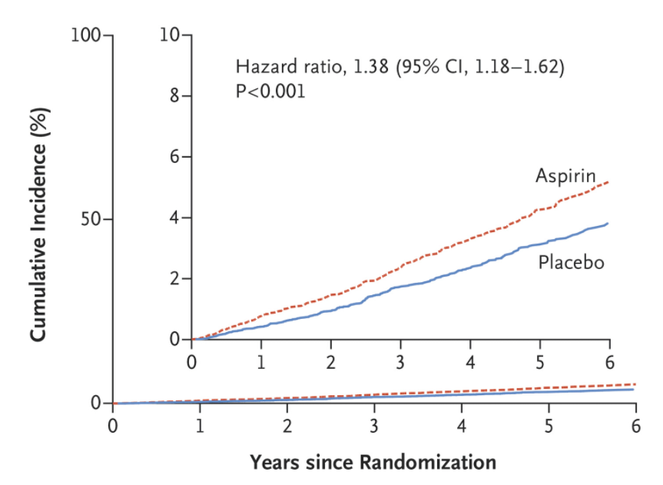
ASPREE Cumulative Incidence of Major Hemorrhage

Slide 12
ASPREE Trial Results
Effect of Aspirin on All-Cause Mortality in the Healthy Elderly - PubMed (nih.gov) N Engl J Med. 2018;379(16):1519.
Higher all-cause mortality was observed among apparently healthy older adults who received daily aspirin than among those who received placebo and was attributed primarily to cancer-related death.
Effect of Aspirin on Disability-free Survival in the Healthy Elderly - PubMed (nih.gov) N Engl J Med. 2018;379(16):1499.
Aspirin use in healthy elderly persons did not prolong disability-free survival over a period of 5 years but led to a higher rate of major hemorrhage than placebo.
Effect of Aspirin on Cardiovascular Events and Bleeding in the Healthy Elderly | NEJM. N Engl J Med. 2018;379(16):1509.
The use of low-dose aspirin as a primary prevention strategy in older adults resulted in a significantly higher risk of major hemorrhage and did not result in a significantly lower risk of cardiovascular disease than placebo.
Higher mortality in aspirin group.

Slide 13
Interpretation of ASPREE
Among HEALTHY elderly patients low-dose aspirin therapy for primary prevention was not beneficial at 4.7 years follow up.
No improvement in disability-free survival, CVD events, cancer
Increased risk of major bleeding and mortality
BUT…the subjects were healthy elderly patients
Exclusion criteria: cardiovascular or cerebrovascular disease, dementia, high bleeding risk
Closer to our population than most studies but not quite there yet.
Summary of Study -- Aspirin in Reducing Events in the Elderly - American College of Cardiology (acc.org)

Slide 14
Safety of Ceasing Aspirin Used Without a Clinical Indication After Age 70 Years: A Subgroup Analysis of the ASPREE Randomized Trial
ASPREE was interpreted by some to be relevant only to initiation of Aspirin and not discontinuation of Aspirin
Study tried to use ASPREE data to answer if aspirin cessation among consistent users had an effect on survival
Not enough statistical power – Inconclusive
Perhaps the ASPREE-XT will improve statistical power
Safety of Ceasing Aspirin Used Without a Clinical Indication After Age 70 Years: A Subgroup Analysis of the ASPREE Randomized Trial | Annals of Internal Medicine (acpjournals.org)
Notes:
A Follow-up study that did a post hoc analysis of the ASPREE data looked at whether or not stopping aspirin had an effect on survival.
unfortunately, the data did not have enough statistical power to draw a conclusion.
In extension of the original trial called ASPREE-XT will hopefully in the future be able to help ask this question

Slide 15
ASPREE Project Continues
Big project with lots of sub-studies
https://aspree.org/usa
ASPREE-XT -- continuation of ASPREE trial beyond 4.7 years
ASPREE Cancer Endpoints Study (ACES)
ASPREE Cancer Treatment Study (ACTS)
ASPREE-D (Depression)
ASPREE-EWAS (Epigenetics)
ASPREE-G (Genomics)
ASPREE Longitudinal Study of Older Persons (ALSOP)
ASPREE-XT Microbiome
Notes:
you can access all of the information about the APREE project on the projects web site.
there are a number of follow-up studies in process to extend the ASPREE data.
since all of the participants in these studies are greater than 70 years of age
I’m hopeful we will see some of our other questions answered about this population as well.

Slide 16
ASCEND Trial 2018
Effects of Aspirin for Primary Prevention in Persons with Diabetes Mellitus - NEJM
RCT of Aspirin 100mg qd vs placebo; N 15,480; type 2 DM w/out evidence of CVD; follow-up of 7.4 years
Primary outcome: first serious vascular event ( MI, CVA/TIA, vascular related death, excluding intracranial hemorrhage)
Vascular events significantly lowered
Aspirin 8.5% vs. Placebo 9.6% (rate ratio 0.88; 95% CI, 0.79 - 0.97; P=0.01)
Major bleeding events were significantly increased
Aspirin 314 participants (4.1%) vs Placebo 245 (3.2%) (rate ratio 1.29; 95% CI, 1.09 - 1.52; P=0.003),
Mostly GI bleeding and other extracranial bleeding.
No significant difference in the incidence of GI tract cancer
Aspirin use prevented serious vascular events in persons who had diabetes and no evident cardiovascular disease but caused major bleeding events. The absolute benefits were largely counterbalanced by the bleeding hazard.
Notes:
RATE Ratio ➔ In epidemiology, a rate ratio, sometimes called an incidence density ratio or incidence rate ratio, is a relative difference measure used to compare the incidence rates of events occurring at any given point in time.

Slide 17
ARRIVE Trial 2018 Aspirin to Reduce Risk of Initial Vascular Events
Use of aspirin to reduce risk of initial vascular events in patients at moderate risk of cardiovascular disease (ARRIVE)
Aspirin 100mg qd vs placebo; n = 12,546; Median follow up 5 yrs
Primary care setting, double-blinded, placebo-controlled, multicenter study (7 countries); nondiabetic patients with a moderate risk (ASCVD 10–20% 10-year risk) of CAD
Men >50 y/o; Women >60 y/o; avg age 63.9
Primary outcome: Cardiovascular death, MI, unstable angina, CVA/TIA
Exclusion criteria: High risk of bleeding, diabetes
Aspirin did not lower the risk of major CV events
Aspirin 4.3% vs placebo 4.5% (p=0.60)
Significant number of GI bleeds
aspirin 61 (0.97%) vs Placebo 29 (0.46%) (p=0·0007)
Even though high GI bleed risk was an exclusion criteria.
Summary - Aspirin to Reduce Risk of Initial Vascular Events - American College of Cardiology (acc.org)
Notes:
So aspirin did not lower the risk of major cardiovascular events.
And, they saw a significant number of GI bleeds even though one of their exclusion criteria was high risk for GI bleed.
the also signed lower risk for cardiovascular events then would be predicted by the ASCVD calculator
older data
Maybe we are better at managing risk factors not represented in the formula
Many other possible reasons

Slide 18
Do we see a trend?
Probably not much cardiovascular benefit
High risk of bleeding

Slide 19
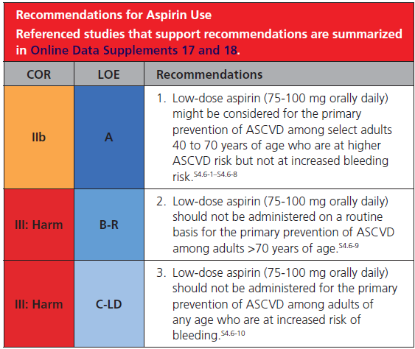
2019 ACC/AHA Guideline for Primary Prevention of CVD
IIb → Benefit equal to or greater than risk
A → High quality evidence
III: Harm → Risk > Benefit
B-R → Moderate quality evidence; 1 or more RCTs
III: Harm → Risk > Benefit
C-LD → Limited Data. Observational studies. Limitations in design.
2019 ACC/AHA Guideline on the Primary Prevention of Cardiovascular Disease: A Report of the American College of Cardiology/American Heart Association Task Force on Clinical Practice Guidelines | Circulation (ahajournals.org)

Slide 20
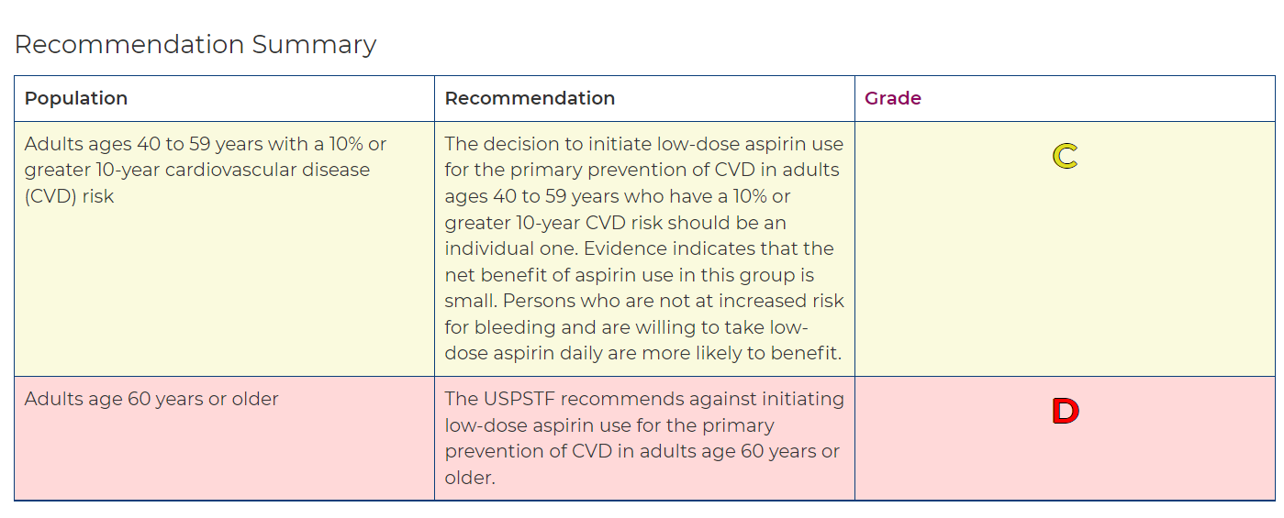
USPSTF Update Pending
Draft Recommendation: Aspirin Use to Prevent Cardiovascular Disease: Preventive Medication | United States Preventive Services Taskforce (uspreventiveservicestaskforce.org)
USPSTF changing recommend from “insufficient evidence” to recommending against starting aspirin for primary prevention in > 60 y/o

Slide 21
Risk of Bleeding with Aspirin
Significant number of bleeding events in ASPREE, ASCEND, and ARRIVE
Mostly GI bleeding but some intracranial
Mortality from non-traumatic intracranial bleeding ~ 40%
Lower dose, lower risk of bleeding
“…limited justification to use aspirin doses >100mg daily for primary prevention.” 2019 ACC/AHA Guideline of PP of CVD
Analysis of risk of bleeding complications after different doses of aspirin in 192,036 patients enrolled in 31 randomized controlled trials - PubMed (nih.gov)

Slide 22
Risk of Bleeding with Aspirin
Bleeding Risks With Aspirin Use for Primary Prevention in Adults: A Systematic Review for the U.S. Preventive Services Task Force - PubMed (nih.gov) 2016
58% increased risk in GI bleeding (OR 1.58, 95% CI 1.29 -1.95])
27% increase in hemorrhagic stroke risk (OR 1.27, CI 0.96 - 1.68])
Frequency of Intracranial Hemorrhage With Low-Dose Aspirin in Individuals Without Symptomatic Cardiovascular Disease: A Systematic Review and Meta-analysis - PubMed (nih.gov)
13 RCTs including ASCEND, ARRIVE, ASPREE
Assess risk of Intracranial hemorrhage in individuals without symptomatic CVD
Low- dose aspirin vs placebo
Increased risk of intracranial bleeding (RR 1.37, 95% CI 1.13-1.66)

Slide 23
Risk of Bleeding with Aspirin
Bleeding risk of aspirin is significant
This same risk probably applies to secondary prevention as well.
What factors trump the bleeding risk for primary prevention? Secondary prevention?
Family hx
Poorly controlled HTN/HLD
Elevated Coronary Ca++ score
ASCVD score >10%
Does a PPI or H2 blocker reduce GI bleeding risk?
Age-specific risks, severity, time course, and outcome of bleeding on long-term antiplatelet treatment after vascular events: a population-based cohort study - PMC (nih.gov)

Slide 24
Aspirin for Secondary Prevention of CVD
What about the data supporting aspirin for secondary prevention
Acute MI, unstable angina
Acute ischemic stroke, post stroke
CAD, post CABG, post MI, PCI/stents
PAD, Carotid artery disease
Data showing efficacy of aspirin in the acute setting is strong
Anti-Thrombotic Trialists’ Collaboration meta-analysis (1970s, 1980s)
Data showing efficacy of aspirin for lifelong secondary prevention is lacking
Follow periods of 4 years in most studies.
Studies using various combinations of P2Y12 inhibitors, aspirin, and anticoagulants are underway.
Lifelong Aspirin for All in the Secondary Prevention of Chronic Coronary Syndrome | Circulation (ahajournals.org)
Notes:
Most of the data proving the role of aspirin and secondary prevention is from the 1970s and 1980s.
there is studies now questioning the role of aspirin and secondary prevention.
Is probably time to look at this issue again.
The first statin was introduced in United States in 1987 and at least some of the data looking at secondary prevention was prior to that.
There are likely a lot of risk factors and other things different now compared to the 70s and 80s which may affect the evaluation of aspirin for secondary prevention.
I think that given the Bleeding risk that we found in the primary prevention trials we will see further study of aspirin as well for secondary prevention of CVD as well.
Data used for secondary prevention does not have a very long follow-up in most studies
And so the idea of lifelong aspirin for secondary prevention is not well supported

Slide 25
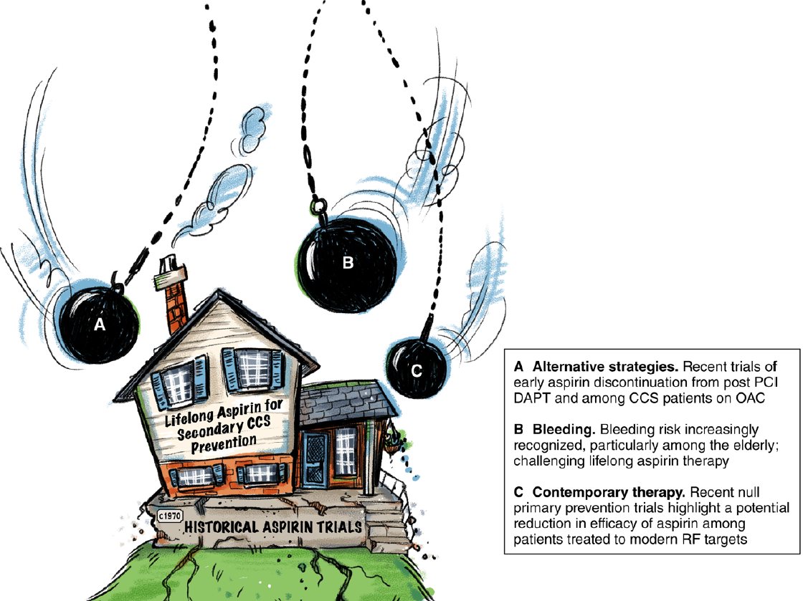
Is it time for a study looking at discontinuation of aspirin for secondary prevention in the elderly?

Slide 26
Aspirin Topics for the future
Role of aspirin in
PVD
Primary/Secondary Prevention of Stroke
Atrial Fibrillation
Comparison of aspirin and DOACs
DVT prophylaxis
Post hip fracture
Comparison of aspirin and DOACs

Slide 27
Thank you for listening David Shepherd

Slide 28
Aspirin Part II

Slide 29
Aspirin for ischemic stroke prevention
Primary prevention
Treatment of acute stroke
Secondary prevention
Stopping aspirin for stroke prevention
Aspirin for prevention of cardioembolic stroke in Afib
Does aspirin prevent cardioembolic stroke?
Bleeding risk
Aspirin vs warfarin
Warfarin vs DOACs
DOAC vs aspirin
Aspirin in PAD/PVD
Current recs
Newer data
Aspirin Scorecard

Slide 30
Aspirin for Stroke Prevention

Slide 31
Aspirin: Primary Prevention of Stroke
ASPREE and ARRIVE
Aspirin did not lower CVD events
Did not prolong disability free survival
Raised risk of major hemorrhage
Raised risk of mortality (primarily related to cancer)
USPSTF
Against aspirin for primary prevention in those > 60
Small benefit in those 40-59 y/o with 10% 10-year CVD risk
Aspirin Use to Prevent Cardiovascular Disease: US Preventive Services Task Force Recommendation Statement | Cardiology | JAMA | JAMA Network

Slide 32
Aspirin Tx of Acute Ischemic Stroke
Risk of recurrence is high in the hours and days after stroke
Recurrence in this time is associated with high fatality
Aspirin within 48 hours is beneficial
Fewer recurrent ischemic strokes
More hemorrhagic transformation?
International Stroke Trial 1997
10 deaths or recurrent strokes avoided per 1000
Chinese Acute Stroke Trial
14% reduction in mortality
Antiplatelet Therapy After Noncardioembolic Stroke | Stroke (ahajournals.org)
Cumulative meta-analysis of aspirin efficacy after cerebral ischaemia of arterial origin - PMC (nih.gov)

Slide 33
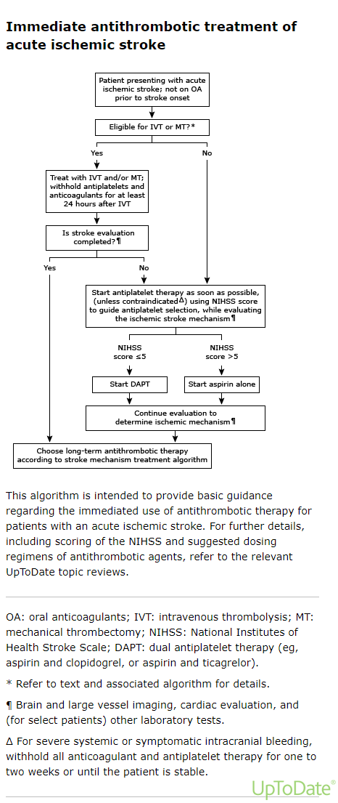
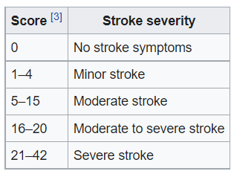
NIHSS

Slide 34
Aspirin: Secondary Prevention
Effects of aspirin on risk and severity of early recurrent stroke after transient ischaemic attack and ischaemic stroke: time-course analysis of randomised trials - The Lancet 2016
Meta-analysis, 12 trials, randomized trials of aspirin vs control in secondary prevention after TIA or ischemic stroke. N=15,778
Aspirin reduced risk of disabling or fatal stroke by 80%
Most benefit in the 2 weeks following stroke
Aspirin reduced recurrence by 60% at 6 weeks after stroke
No reduction in risk after 12 weeks in aspirin group

Slide 35
Aspirin: Secondary Prevention
Have we overestimated the importance of aspirin in long term secondary prevention?
AHA/ACC Recommendation: for long term (>3 mo) secondary prevention
Aspirin monotherapy
Aspirin/Dipyridamole
Better long-term risk reduction than aspirin monotherapy
Caused more major bleeding than aspirin
Clopidigrel
Better long-term benefit than aspirin monotherapy?
Caused less major bleeding than aspirin
***Antiplatelet Therapy After Noncardioembolic Stroke | Stroke (ahajournals.org) 2019***
2021 Guideline for the Prevention of Stroke in Patients With Stroke and Transient Ischemic Attack: A Guideline From the American Heart Association/American Stroke Association | Stroke (ahajournals.org)
Notes:
Antiplatelet Therapy After Noncardioembolic Stroke | Stroke (ahajournals.org) 2019***
We did a network meta-analysis (NMA) of data from 6 randomized trials of the effects of commonly prescribed antiplatelet agents in the long-term (≥3 months) secondary prevention of noncardioembolic stroke or transient ischemic attack. Individual patient data from 43 112 patients were pooled and reanalyzed. Main outcomes were serious vascular events (nonfatal stroke, nonfatal myocardial infarction, or vascular death), major bleeding, and net clinical benefit (serious vascular event or major bleeding). Subgroup analyses were done according to age, sex, ethnicity, hypertension, qualifying diagnosis, type of vessel involved (large versus small vessel disease), and time from qualifying event to randomization.
Results—
Aspirin/dipyridamole combination (RR_{NMA-adj}, 0.83; 95% CI, 0.74–0.94) significantly reduced the risk of vascular events compared with aspirin, as did clopidogrel (RR_{NMA-adj}, 0.88; 95% CI, 0.78–0.98), and aspirin/clopidogrel combination (RR_{NMA-adj}, 0.83; 95% CI, 0.71–0.96). Clopidogrel caused significantly less major bleeding and intracranial hemorrhage than aspirin, aspirin/dipyridamole combination, and aspirin/clopidogrel combination. Aspirin/clopidogrel combination caused significantly more major bleeding than aspirin, aspirin/dipyridamole combination, and clopidogrel. Net clinical benefit was similar for clopidogrel and aspirin/dipyridamole combination (RR_{NMA-adj}, 0.99; 95% CI, 0.93–1.05). Subgroup analyses showed no heterogeneity of treatment effectiveness across prespecified subgroups. The excess risk of major bleeding associated with aspirin/clopidogrel combination compared with clopidogrel alone was higher in patients aged <65 years than it was in patients ≥65 years (RR_{NMA-adj}, 3.9 versus 1.7).

Slide 36
Aspirin Prevention of Ischemic Stroke: Summary
Primary prevention: ASPREE, ARRIVE, USPTF
>60 y/o – No
40-59 y/o Probably no
Acute treatment: Definite recommendation for Aspirin (or DAPT)
Most important during the first 6 weeks after stroke
Secondary prevention: Still recommended (for now)
~14% reduction in recurrent stroke at 6 weeks
Risk reduction after 12 weeks?
Aspirin/dipyridamole and clopidogrel may be better
Aspirin in the primary and secondary prevention of vascular disease: collaborative meta-analysis of individual participant data from randomised trials - The Lancet
Long-term antithrombotic therapy for the secondary prevention of ischemic stroke - UpToDate

Slide 37
Is stopping aspirin in secondary prevention dangerous?
Effect of Discontinuing Aspirin Therapy on the Risk of Brain Ischemic Stroke | Cerebrovascular Disease | JAMA Neurology | JAMA Network
Case control study; N=309
Stopping aspirin as a risk factor for ischemic stroke
13 patients stopped aspirin within 4 weeks of stroke
OR 3.4 (p<0.005)
Stopping the aspirin increased risk of stroke

Slide 38
Aspirin for Prevention of Cardioembolic Stroke in Atrial Fibrillation

Slide 39
Case
Avery Fibrilator is an 85-year-old male you are admitting to your LTC facility. He has atrial fibrillation and is taking metoprolol and aspirin. He is able to make his own decisions and his mentation is excellent. He has had 3 falls over the last year with no significant injuries. He was living alone at home and his family checked in on him daily. He and his family have become concerned about his safety and have decided that LTC is his best option. They ask you to manage his medications using the best evidence-based information and are agreeable to any recommendations that you make.
What medication adjustments would you make?
A.) Continue aspirin for Afib related embolic stroke prevention
B.) Discontinue aspirin
C.) Discontinue aspirin and start apixaban
D.) Continue aspirin and add clopidogrel

Slide 40
Atrial Fibrillation in the Elderly
Prevalence of ~4% of those > 60 years of age
Afib increases stroke risk 5-fold
Number of Afib related strokes increases with age
1.5% at age 50 to 59
2.8% at age 60 to 69
9.9% at age 70 to 79
23.5% at age 80 to 89
Overview of atrial fibrillation - UpToDate
Fall risk and anticoagulation for atrial fibrillation in the elderly: A delicate balance | Cleveland Clinic Journal of Medicine (ccjm.org)

Slide 41
Does Aspirin Prevent Afib Related Strokes?
Stroke Prevention in Atrial Fibrillation Study. Final results. | Circulation (ahajournals.org) – SPAF trial 1991
Aspirin reduced Afib related strokes by 42%
Warfarin reduced Afib related strokes by 67%
Meta-analysis: Antithrombotic Therapy to Prevent Stroke in Patients Who Have Nonvalvular Atrial Fibrillation | Annals of Internal Medicine (acpjournals.org) 2007
Aspirin reduced Afib related strokes by 20%
Warfarin reduced Afib related strokes by 60%
Aspirin has a larger effect on non-cardioembolic strokes than cardioembolic strokes
Notes:
Meta analysis in 2007 looked at 29 studies.

Slide 42
Bleeding Risk: Aspirin vs Warfarin
Warfarin versus aspirin for stroke prevention in an elderly community population with atrial fibrillation (the Birmingham Atrial Fibrillation Treatment of the Aged Study, BAFTA): a randomized controlled trial - The Lancet 2007
Aspirin has the same bleeding risk as warfarin but is not as effective at preventing Afib related stroke.
Warfarin was superior in reducing thromboembolism risk
Risk of major bleeding or intracranial hemorrhage was about the same

Slide 43
Bleeding Risk: Warfarin vs DOACs
DOACs are safer and noninferior to warfarin
Rivaroxaban versus Warfarin in Nonvalvular Atrial Fibrillation | NEJM
Rivaroxaban was noninferior to warfarin for the prevention of stroke or systemic embolism
Apixaban versus Warfarin in Patients with Atrial Fibrillation | NEJM
Apixaban was superior to warfarin in preventing stroke or systemic embolism, caused less bleeding, and resulted in lower mortality

Slide 44
Bleeding Risk: DOAC vs Aspirin
Thromboembolic Risk, Bleeding Outcomes and Effect of Different Antithrombotic Strategies in Very Elderly Patients With Atrial Fibrillation: A Sub-Analysis From the PREFER in AF (PREvention oF Thromboembolic Events; European Registry in Atrial Fibrillation) (nih.gov)
DOAC bleeding risk was not higher than that of patients receiving antiplatelet treatment
The older the patients with AF, the higher was the weighted net clinical benefit in favor of anticoagulant therapy
Effect of Age on Stroke Prevention Therapy in Patients With Atrial Fibrillation | Stroke (ahajournals.org)
Aspirin becomes less effective at preventing stroke as we age but the bleeding risk stays the same
DOAC efficacy is stable

Slide 45
Misperceptions of aspirin efficacy and safety may perpetuate anticoagulant underutilization in atrial fibrillation | European Heart Journal | Oxford Academic (oup.com)
“Underutilization of OAC for AF may be perpetuated by aspirin remaining a soft option for physicians, based on misperceptions of both safety and efficacy of aspirin.”

Slide 46
Aspirin in Afib Summary
Aspirin no longer has a role in stroke prevention for Afib
Aspirin reduced Afib related stroke risk 20%
Warfarin reduces Afib related stroke risk 60%
DOACS are noninferior to warfarin and probably safer
Aspirin has the same bleeding risk as warfarin/DOACs
Aspirin has significantly less efficacy compared to DOACs
Aspirin is not safer in frail, elderly, Afib patients
The European Society of Cardiology does not support antiplatelet monotherapy for stroke prevention irrespective of stroke risk.
The 2019 AHA/ACC/HRS focused update omits any recommendation for aspirin in patients with low risk.

Slide 47
References
Is It Time to Start Stopping Aspirin for Stroke Prevention in Afib? | MedPage Today
Treating atrial fibrillation with antiplatelet drugs in the elderly: pro and contra arguments (escardio.org)
Fall risk and anticoagulation for atrial fibrillation in the elderly: A delicate balance | Cleveland Clinic Journal of Medicine (ccjm.org)
Misperceptions of aspirin efficacy and safety may perpetuate anticoagulant underutilization in atrial fibrillation | European Heart Journal | Oxford Academic (oup.com)

Slide 48
Aspirin in PAD/PVD

Slide 49
Aspirin in PAD/PVD
Recs for Aspirin in PAD/PVD
Based on data from the Antithrombotic Trialists Collaboration 2002 and other similar studies
Goal is CVD risk reduction
AHA/ACC Recs for PAD
Aspirin for primary prevention
Aspirin (or clopidigrel) for secondary prevention in symptomatic PAD
Aspirin (or clopidigrel) for secondary prevention in Asymptomatic PAD with low ABI is reasonable
European guidelines
Against antiplatelet therapy in Asymptomatic PAD
Aspirin Monotherapy Should Not Be Recommended for Cardioprotection in Patients With Symptomatic Peripheral Artery Disease | Circulation (ahajournals.org)
ACC/AHA Versus ESC Guidelines for Diagnosis and Management of Peripheral Artery Disease: JACC Guideline Comparison - ScienceDirect

Slide 50
Aspirin in PAD/PVD
Newer studies looking specifically at PAD/PVD exist
In patients with PAD, treatment with aspirin alone or with dipyridamole resulted in a statistically nonsignificant decrease in the primary end point of cardiovascular events and a significant reduction in nonfatal stroke. JAMA 2009
In patients with no clinical CVD but with low ABI aspirin did not result in a significant reduction in vascular events. JAMA 2010
COMPASS Trial 2018
Low dose rivaroxaban + aspirin and rivaroxaban monotherapy both reduced major adverse limb events.
Increased bleeding with addition of rivaroxaban
Rivaroxaban with or without aspirin in patients with stable peripheral or carotid artery disease: an international, randomised, double-blind, placebo-controlled trial - PubMed (nih.gov)

Slide 51
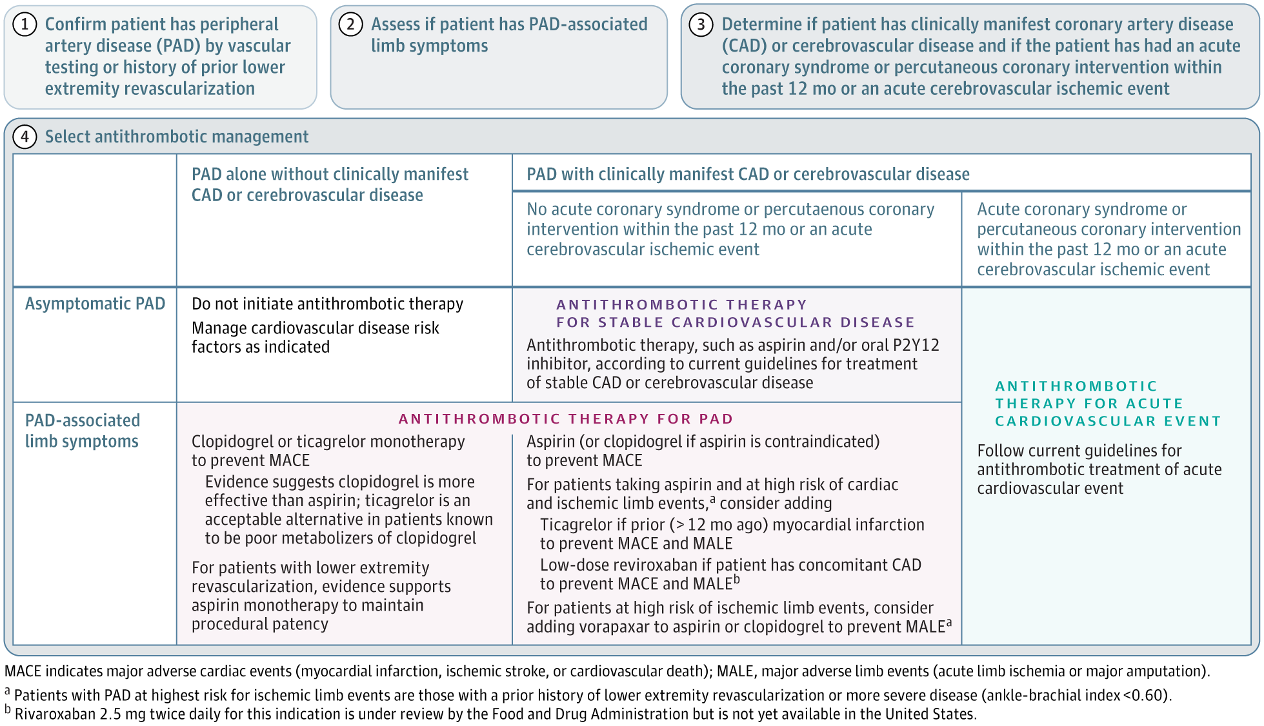
Aspirin in PVD
Antithrombotic Therapy for Peripheral Artery Disease in 2018 | Cardiology | JAMA | JAMA Network
Antithrombotic Therapy for Peripheral Artery Disease in 2018

Slide 52
Aspirin in PAD/PVD Summary
Asymptomatic PAD without CVD
No aspirin
Symptomatic PAD without CVD
Clopidogrel
Aspirin monotherapy after revascularization
Asymptomatic PAD with CVD
Aspirin or clopidogrel based on CVD guidelines
Symptomatic PAD with CVD
Aspirin
Consider adding rivaroxaban for those at high risk of critical limb ischemia
Antithrombotic Therapy for Peripheral Artery Disease in 2018 | Cardiology | JAMA | JAMA Network

Slide 53
Aspirin for Prevention Scorecard
Catagory | Aspirin |  | Notes
 | Yes | No
Primary Prevention CVD |  | x | Cardiovascular death, MI, CVA/TIA, PAD/PVD
STROKE
Afib stroke prevention |  | x | DOACs have superior efficacy with bleeding risk similar to aspirin
Short-term Secondary prevention of ischemic stroke | ++ |  | Strong efficacy for first 6 weeks post stroke
Long-term Secondary prevention of ischemic stroke | ? |  | Recommendations are to continue long term therapy Possibly diminishing returns after 12 weeks
PAD/PVD
Asymptomatic PAD w/out CVD |  | x
Symptomatic PAD w/out CVD |  | x | Clopidogrel preferred. Aspirin monotherapy reserved for after revascularization
Asymptomatic PAD with CVD | x |  | Aspirin or Clopidogrel based on CVD guidelines
Symptomatic PAD with CVD | x |  | Possible second agent for if high risk for critical limb ischemia

Slide 54
Case
Avery Fibrillator is an 85-year-old male you are admitting to your LTC facility. He has atrial fibrillation and is taking metoprolol and aspirin. He is able to make his own decisions and his mentation is excellent. He has had 3 falls over the last year with no significant injuries. He was living alone at home and his family checked in on him daily. He and his family have become concerned about his safety and have decided that LTC is his best option. They ask you to manage his medications using the best evidence-based information and are agreeable to any recommendations that you make.
What medication adjustments would you make?
A.) Continue aspirin for Afib related embolic stroke prevention
B.) Discontinue aspirin
C.) Discontinue aspirin and start apixaban
D.) Continue aspirin and add clopidogrel

Slide 55
Case
You perform a physical exam on Avery and note that he has no hair on his legs, cold feet, and bilaterally reduced peripheral pulses. He denies any claudication but admits to LE weakness and balance issues that he thinks have led to his falls over the last year. You dig through his records and find that he had doppler US ABIs done last year showing a RLE ABI or 0.8 and LLE ABI 0.9.
Does this change your answer?
What medication adjustments would you make?
A.) Continue aspirin for Afib related embolic stroke prevention
B.) Discontinue aspirin
C.) Discontinue aspirin and start apixaban
D.) Continue aspirin and add clopidogrel
E.) Discontinue aspirin and start clopidogrel
F.) Obtain LE CTA

Slide 56
Extra Slides

Slide 57
Aspirin for DVT prophylaxis
Can we use Aspirin for DVT prophy in hip fracture with non-surgical management?

Slide 58
Aspirin for DVT prophylaxis after hip fracture surgery
Prevention of pulmonary embolism and deep vein thrombosis with low dose aspirin: Pulmonary Embolism Prevention (PEP) trial - PubMed (nih.gov)
In a randomized trial of almost 18,000 patients, most of whom had hip fracture surgery/HFS, compared with placebo, aspirin administered for 35 days reduced the incidence of symptomatic DVT without an increase in major bleeding events but had no effect on the rate of clinically significant PE [98].
Intermittent Pneumatic Compression for the Prevention of Venous Thromboembolism after Total Hip Arthroplasty - PubMed (nih.gov) Clin Orthop Surg . 2017 Mar;9(1):37-42. doi: 10.4055/cios.2017.9.1.37. Epub 2017 Feb 13.
In a randomized trial of 275 patients undergoing TKA, when used in combination with pneumatic compression devices, four weeks of aspirin had similar rates of DVT when compared with LMW heparin (18 versus 14 percent) [78]. In another trial in patients with THA, IPC devices in combination with six weeks of aspirin did not result in a significant reduction in rates of VTE compared with aspirin alone [136].
Association of Aspirin With Prevention of Venous Thromboembolism in Patients After Total Knee Arthroplasty Compared With Other Anticoagulants: A Noninferiority Analysis - PubMed (nih.gov) JAMA Surg. 2019 Jan 1;154(1):65-72.
In a review of the Michigan Arthroplasty registry of over 41,000 patients undergoing TKA, the overall incidence of VTE was 1.38 percent [142]. The incidence was 4.79 percent among those who received no pharmacologic prophylaxis, 1.42 percent for those treated with anticoagulation alone (various agents and combinations), 1.31 percent for those prescribed both anticoagulation and aspirin, and 1.16 percent for those treated with aspirin alone. Bleeding occurred in 1.10 percent of patients overall, and in 1.50, 1.35, 1.14 and 0.90 percent of the no prophylaxis, anticoagulation and aspirin, anticoagulation, and aspirin groups, respectively. Aspirin alone was noninferior for both the composite VTE outcome (unadjusted analysis) and for bleeding complications (unadjusted and adjusted analysis) compared with other nonaspirin treatment.
Notes:
Mixed evidence but it seems to favor aspirin as non-inferior to other pharmacological DVT prevention strategies.
Bleeding risk does not seem to be increased with aspirin but it does not seem to be much lower either. It may not be a safer strategy.
Quality of some trials is not great.

Slide 59
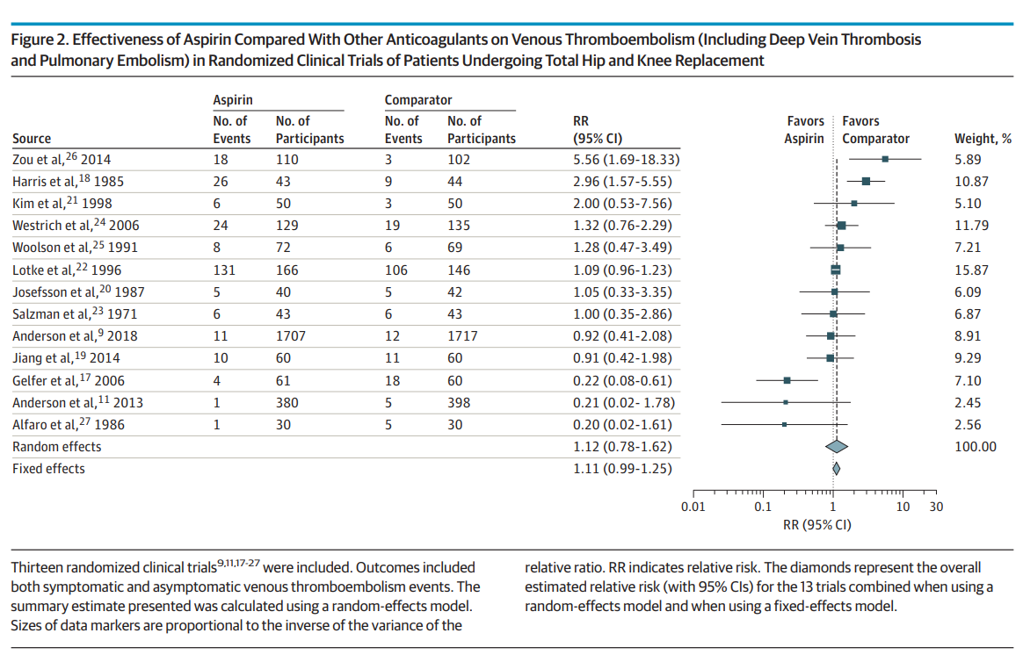
Clinical Effectiveness and Safety of Aspirin for Venous Thromboembolism Prophylaxis After Total Hip and Knee Replacement: A Systematic Review and Meta-analysis of Randomized Clinical Trials | Orthopedics | JAMA Internal Medicine | JAMA Network - Feb 3, 2020
Wide range of findings from RCTs. RCTs with Placebo control group excluded.
Primary outcome was postoperative DVT.
No statistically significant difference between Aspirin and commonly used anticoagulants.
No significant difference in the risk of adverse events.
Most trials in the study had high rates of bias
The Anderson et al RCT gave 5 days of rivaroxiban prior to aspirin.

Slide 60
Aspirin in healthy individuals to modify VTE risk
Effect of low-dose aspirin on the occurrence of venous thromboembolism: a randomized trial - PubMed (nih.gov)
In the Women's Health Study, VTE rates were no different in healthy females that were randomly assigned to receive either low-dose aspirin (100 mg orally every other day) or placebo for 10 years (1.18 versus 1.25 events per 1000 patient-years) [60]. On subgroup analysis, no VTE risk factor (ie, age, obesity, menopausal status, reported VTE at baseline, factor V Leiden, prothrombin gene mutation) modified the relationship between aspirin and the overall risk of VTE. However, the use of aspirin was associated with an increased risk of gastrointestinal bleeding, peptic ulcer, hematuria, bruising, and epistaxis.

Slide 61
Lower Extremity Peripheral Artery Disease: AHA Scientific Statement - American College of Cardiology (acc.org)

Slide 62
Of Life and Limb: Addition of Low-Dose Rivaroxaban for Secondary Prevention After Peripheral Artery Disease Surgery | Circulation (ahajournals.org)
compared CAD+PAD patients, patients with PAD only are less likely to receive antiplatelet drugs, statins, or smoking-cessation interventions

Slide 63
Antiplatelet Therapy After Noncardioembolic Stroke - PubMed (nih.gov) 2019
network meta-analysis (NMA) of data from 6 randomized trials of the effects of commonly prescribed antiplatelet agents in the long-term (≥3 months) secondary prevention of noncardioembolic stroke or transient ischemic attack.
Aspirin/dipyridamole combination (RR_{NMA-adj}, 0.83; 95% CI, 0.74-0.94) significantly reduced the risk of vascular events compared with aspirin, as did clopidogrel (RR_{NMA-adj}, 0.88; 95% CI, 0.78-0.98), and aspirin/clopidogrel combination (RR_{NMA-adj}, 0.83; 95% CI, 0.71-0.96)
Clopidogrel caused significantly less major bleeding and intracranial hemorrhage than aspirin, aspirin/dipyridamole combination, and aspirin/clopidogrel combination.
Net clinical benefit was similar for clopidogrel and aspirin/dipyridamole combination (RR_{NMA-adj}, 0.99; 95% CI, 0.93-1.05).
The excess risk of major bleeding associated with aspirin/clopidogrel combination compared with clopidogrel alone was higher in patients aged <65 years than it was in patients ≥65 years (RR_{NMA-adj}, 3.9 versus 1.7).
Conclusions- Results favor clopidogrel and aspirin/dipyridamole combination for long-term secondary prevention after noncardioembolic stroke or transient ischemic attack, regardless of patient characteristics. Aspirin/clopidogrel combination was associated with a significantly higher risk of major bleeding compared with other antiplatelet regimens.

Slide 64
Risk of stopping antiplatelet treatment — Stopping antiplatelet therapy in high-risk patients may itself increase the risk of stroke. One study found that 13 of 289 patients hospitalized with cerebral infarction had recently stopped antiplatelet therapy; most had been taking aspirin [6]. In all 13, the antiplatelet agent had been discontinued within 6 to 10 days of stroke onset, a time course consistent with the known lifespan (about 10 days) of inhibited platelets. Additionally, a case-control study comparing 309 patients with stroke to 309 matched controls found that discontinuation of aspirin was associated with a significantly increased risk of TIA or ischemic stroke (odds ratio 3.4, 95% CI 1.08-10.63) [7].
Long-term antithrombotic therapy for the secondary prevention of ischemic stroke - UpToDate

Slide 65
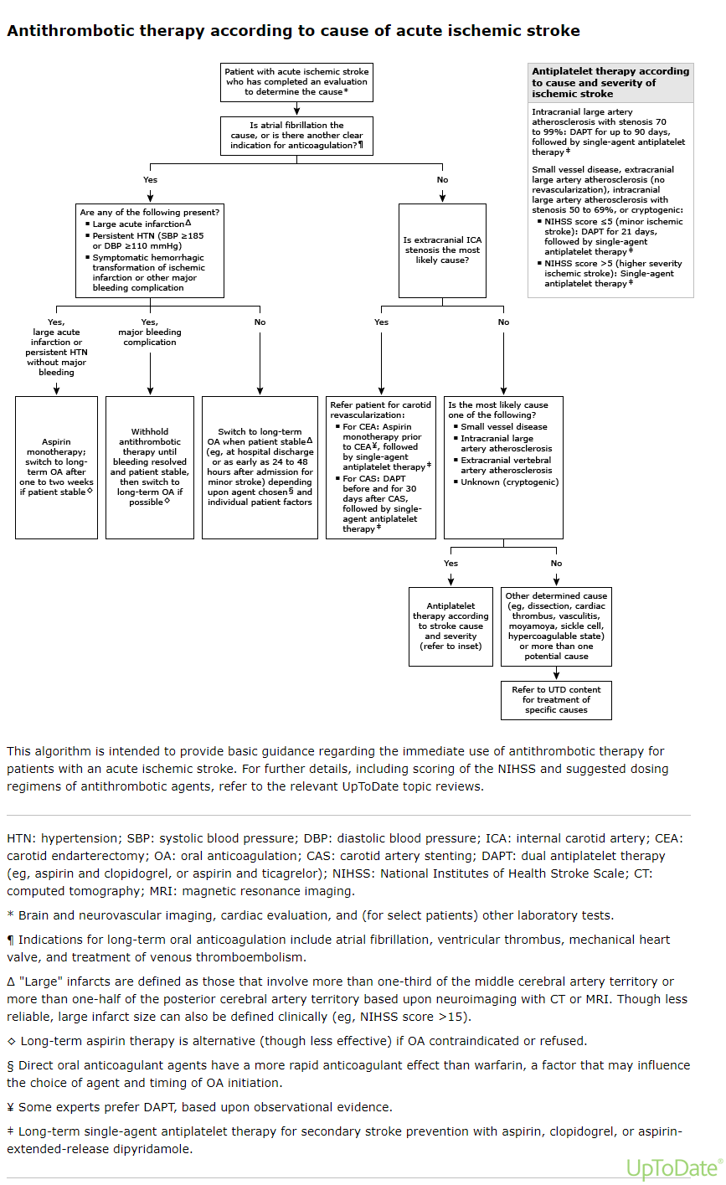
Long-term antithrombotic therapy for the secondary prevention of ischemic stroke - UpToDate

Slide 66
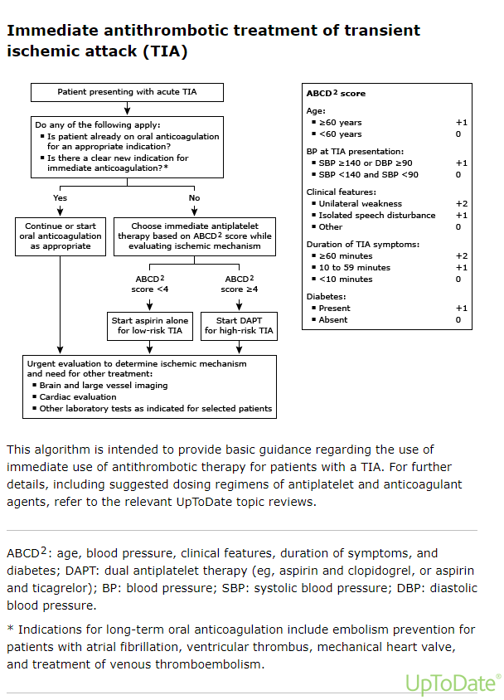

Slide 67
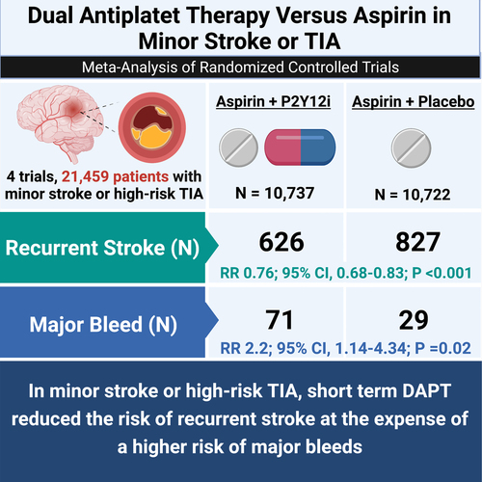
© 2021 American Heart Association, Inc.
Kirtipal Bhatia. Stroke. Dual Antiplatelet Therapy Versus Aspirin in Patients With Stroke or Transient Ischemic Attack: Meta-Analysis of Randomized Controlled Trials, Volume: 52, Issue: 6, Pages: e217-e223, DOI: (10.1161/STROKEAHA.120.033033)

Slide 69
Do we need to use plavix with aspirin in CVA?

Slide 70
Interesting facts
Enteric coated aspirin does not protect against GI bleeding.
Risk of aspirin-associated major upper-gastrointestinal bleeding with enteric-coated or buffered product - PubMed (nih.gov)

Slide 71
Antithrombotic Trialists Collaboration
Collaborative meta-analysis of randomised trials of antiplatelet therapy for prevention of death, myocardial infarction, and stroke in high risk patients (nih.gov)
2002 meta-analysis from Antithrombotic Trialists Collaboration included 195 randomized controlled trials of high-risk patients
Primary prevention: 25% RRR in nonfatal stroke compared to placebo
Secondary prevention: 22% reduction
Benefit independent of age, diabetes, hypertension, sex
Low dose as effective as higher doses
Long-term antithrombotic therapy for the secondary prevention of ischemic stroke - UpToDate
Notes:
ASA dose --

Slide 72
Bleeding risks with novel oral anticoagulants especially rivaroxaban versus aspirin: a meta-analysis – Oct 2021
The bleeding risks associated with NOACs depend on drug type and dosage. For ≥15 mg/day of rivaroxaban, the risk of ICH was significantly higher than that with aspirin. However, further studies comparing dabigatran etexilate and apixaban versus aspirin are warranted to draw a definite conclusion.
Bleeding risks with novel oral anticoagulants especially rivaroxaban versus aspirin: a meta-analysis | Thrombosis Journal | Full Text (biomedcentral.com)

Slide 73
Aspirin for CVA prevention
Collaborative meta-analysis of randomised trials of antiplatelet therapy for prevention of death, myocardial infarction, and stroke in high risk patients (nih.gov) – 1/12/2002
2002 meta-analysis from Antithrombotic Trialists Collaboration included 195 randomized controlled trials of high risk patients
Primary prevention: 25% RRR in nonfatal stroke compared to placebo (p<0.0001)
Secondary prevention: 22% reduction
Benefit independent of sex, age, diabetes, hypertension
Low dose as effective as higher doses.
So it is good for primary prevention? Right?

Slide 74
Aspirin for CVA prevention
Aspirin for the Primary Prevention of Cardiovascular Events: A Systematic Evidence Review for the U.S. Preventive Services Task Force - PubMed (nih.gov) -- 2016
Aspirin has no significant benefit on non-fatal stroke
RR 0.95, 95% CI 0.85-1.06

Slide 75
Aspirin use in endovascular stroke treatment.
MR CLEAN-MED Trial
Safety and efficacy of aspirin, unfractionated heparin, both, or neither during endovascular stroke treatment (MR CLEAN-MED): an open-label, multicentre, randomised controlled trial - The LancetS
Interpretation
Periprocedural intravenous aspirin and unfractionated heparin during endovascular stroke treatment are both associated with an increased risk of symptomatic intracranial haemorrhage without evidence for a beneficial effect on functional outcome.

Slide 76
DAPT for CVA
Clopidogrel and aspirin versus aspirin alone for the prevention of atherothrombotic events - PubMed (nih.gov)
RCCT, 15,603 patients with either clinically evident cardiovascular disease or multiple risk factors to receive clopidogrel (75 mg per day) plus low-dose aspirin (75 to 162 mg per day) or placebo plus low-dose aspirin and followed them for a median of 28 months.
Overall, clopidogrel plus aspirin was not significantly more effective than aspirin alone in reducing the rate of myocardial infarction, stroke, or death from cardiovascular causes.
Aspirin and clopidogrel compared with clopidogrel alone after recent ischaemic stroke or transient ischaemic attack in high-risk patients (MATCH): randomised, double-blind, placebo-controlled trial - The Lancet
Adding aspirin to clopidogrel in high-risk patients with recent ischaemic stroke or transient ischaemic attack is associated with a non-significant difference in reducing major vascular events. However, the risk of life-threatening or major bleeding is increased by the addition of aspirin.
Effects of clopidogrel added to aspirin in patients with recent lacunar stroke - PubMed (nih.gov)
Double blind, multicenter trial, n=3020, pts with recent lacunar infarcts.
Among patients with recent lacunar strokes, the addition of clopidogrel to aspirin did not significantly reduce the risk of recurrent stroke and did significantly increase the risk of bleeding and death.

