Slide 1
Treatment of Restless Legs Syndrome and Periodic Limb Movement Disorder: an American Academy of Sleep Medicine Clinical Practice Guideline
American Academy of Sleep Medicine (AASM)

Slide 2
Background
Primary RLS: Idiopathic
familial link in 40-60%
Several genetic loci possibly associated with RLS, some involving dopamine signaling and iron metabolism
Secondary RLS: Caused by an identifiable condition
Assess for and address exacerbating factors
Alcohol, caffeine, antihistaminergic meds, serotonergic meds, antidopaminergic meds
CKD
Sleep apnea, PLMS (PLMS vs RLS )

Slide 3
Comparison: RLS vs PLMS
Aspect | Restless Legs Syndrome (RLS) | Periodic Limb Movements in Sleep (PLMS)
Timing | Occurs during wakefulness | Occurs exclusively during sleep
Symptoms | Urge to move legs; uncomfortable sensations | Involuntary limb movements
Awareness | Patient is aware | Patient is often unaware
Diagnosis | Based on clinical history | Confirmed via polysomnography
Treatment | Dopaminergic agents, gabapentinoids, iron supplements | Focus on underlying conditions
1. American Academy of Sleep Medicine (AASM): 'Clinical Practice Guidelines for RLS and PLMS’, https://jcsm.aasm.org/doi/pdf/10.5664/jcsm.11390
2. UpToDate: 'Clinical features and diagnosis of restless legs syndrome and periodic limb movement disorder in adults’, https://www.uptodate.com/contents/clinical-features-and-diagnosis-of-restless-legs-syndrome-and-periodic-limb-movement-disorder-in-adults

Slide 4
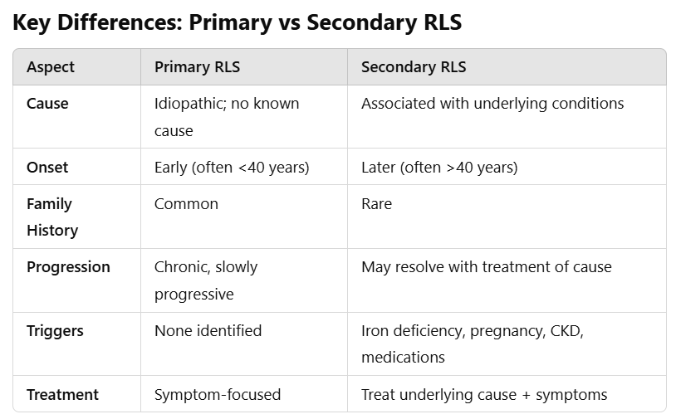

Slide 5
RLS Treatment Recommendations Overview
Issued by the American Academy of Sleep Medicine (AASM)
Target group: Adults with Restless Legs Syndrome (RLS)
Recommendations classified as 'strong' or 'conditional' with varying levels of evidence

Slide 6
Summary of the Updates
Evaluate for and treat underlying conditions that can exacerbate RLS
Iron Deficiency
OSA, PLMS
CKD, ESRD
Alcohol, caffeine, antihistaminergic, serotonergic, antidopaminergic medications
Diabetes, COPD
Check iron status and supplement iron if indicated
Strong recommendation for alpha-2-delta ligands as first line therapies for RLS
Gabapentin enacarbil, Gabapentin, Pregabalin
Move away from using dopaminergic drugs (pramipexole, ropinirole, rotigotine) as first line agents due to risk of augmentation.
New Non-pharm treatment: high-frequency peroneal nerve stimulation

Slide 7
Good Practice Statement for RLS Management
#1 First Step
Address exacerbating factors
Alcohol, caffeine, antihistaminergic, serotonergic, antidopaminergic medications
Untreated obstructive sleep apnea
CKD
Pregnancy

Slide 8
Good Practice Statement for RLS Management
Iron Studies
Regular testing of serum iron studies (ferritin and transferrin saturation) is essential for patients with significant RLS
Conduct iron tests in the morning and avoid iron supplements/foods 24 hours before test
Iron Supplementation Thresholds:
Adults:
Serum ferritin ≤ 75 ng/mL or transferrin saturation < 20% (oral/IV).
Use only IV iron for ferritin levels 75–100 ng/mL.
Children: Serum ferritin < 50 ng/mL (oral/IV).
Thresholds differ from general population recommendations.

Slide 9
Strong Recommendations for Specific Treatments
Gabapentin Enacarbil: Recommended over no treatment
Gabapentin: Recommended over no treatment
Pregabalin: Recommended over no treatment.
What is Gabapentin Enacarbil?
IV ferric carboxymaltose: Recommended for patients with appropriate iron status.
Cabergoline: Strongly recommended against use

Slide 10
Comparison of Gabapentin, Gabapentin Enacarbil, and Pregabalin (with Cost)
Aspect | Gabapentin | Gabapentin Enacarbil | Pregabalin
Mechanism of Action | Binds to α2δ subunit of voltage-gated calcium channels, reducing excitatory neurotransmitter release | Prodrug of gabapentin; converted to gabapentin in the intestine for extended effect | Binds to α2δ subunit of voltage-gated calcium channels, reducing excitatory neurotransmitter release
Half-Life | 5-7 hours | 5-7 hours (similar to gabapentin) | 6-7 hours
Absorption | Variable, saturable absorption via L-amino acid transport system in the intestine | Non-saturable absorption, enabling dose-proportional pharmacokinetics | Linear absorption, not saturable
Bioavailability | Decreases with increasing doses (30-60%) | Consistently high (~68-75%) regardless of dose | High (~90%)
Clinical Indication for RLS | Off-label use for moderate to severe RLS symptoms | FDA-approved for moderate to severe RLS | Off-label use for RLS; effective for severe cases or refractory symptoms
Estimated Cost (per month) | $10-$20 (generic) | $300-$500 | $100-$150 (generic)

Slide 11
Conditional Recommendations (Iron Treatments)
Ferrous Sulfate: Suggested for appropriate iron status (moderate certainty)
IV Low Molecular Weight Iron Dextran: Suggested for appropriate iron status (very low certainty)
IV Ferumoxytol: Suggested for appropriate iron status (very low certainty)

Slide 12
Conditional Recommendations (Other Therapies)
Dipyridamole: Suggested over no treatment (low certainty).
Extended-release Oxycodone & Opioids: Suggested over no treatment (moderate certainty).
High-Frequency Peroneal Nerve Stimulation: Suggested over no stimulation (moderate certainty).
Bilateral high-frequency noninvasive peroneal nerve stimulation evokes tonic leg muscle activation for sleep-compatible reduction of restless legs syndrome symptoms | Journal of Clinical Sleep Medicine
Results Posted | Noninvasive Peripheral Nerve Stimulation for Medication-Refractory Primary RLS (The RESTFUL Study) | ClinicalTrials.gov
Efficacy and safety of tonic motor activation (TOMAC) for medication-refractory restless legs syndrome: a randomized clinical trial – PMC

Slide 13
Nidra – RLS Relief

Slide 15
Treatments to Use with Caution
Levodopa, Pramipexole, Rotigotine, Ropinirole
Not recommended for standard use
May be considered for short-term relief where benefits outweigh long-term risks (e.g., augmentation)
Augmentation: DA medications may be effective initially but over time there is a worsening of symptoms with prolonged use.
Recommendations for the Prevention and Treatment of RLS Augmentation: https://www.rls.org/file/publication-loader/Recommendations-for-Augmentation-Final.pdf
Increased risk of psychiatric side effects
Increased Risk for New-Onset Psychiatric Adverse Events in Patients With Newly Diagnosed Primary Restless Legs Syndrome Who Initiate Treatment With Dopamine Agonists: A Large-Scale Retrospective Claims Matched-Cohort Analysis | Journal of Clinical Sleep Medicine

Slide 16
Treatments Not Recommended
Bupropion
Carbamazepine
Clonazepam
Valerian
Valproic Acid
Cabergoline

Slide 18
Dopamine Agonist Withdrawal Syndrome (DAWS)
Characterized by anxiety, panic attacks, depression agitation, irritability, dysphoria, insomnia, fatigue, generalized pain, and drug cravings.

Slide 20
Distinction Between RLS and PLMS

Slide 21
Comparison: RLS vs PLMS
Aspect | Restless Legs Syndrome (RLS) | Periodic Limb Movements in Sleep (PLMS)
Timing | Occurs during wakefulness | Occurs exclusively during sleep
Symptoms | Urge to move legs; uncomfortable sensations | Involuntary limb movements
Awareness | Patient is aware | Patient is often unaware
Diagnosis | Based on clinical history | Confirmed via polysomnography
Treatment | Dopaminergic agents, gabapentinoids, iron supplements | Focus on underlying conditions
1. American Academy of Sleep Medicine (AASM): 'Clinical Practice Guidelines for RLS and PLMS’, https://jcsm.aasm.org/doi/pdf/10.5664/jcsm.11390
2. UpToDate: 'Clinical features and diagnosis of restless legs syndrome and periodic limb movement disorder in adults’, https://www.uptodate.com/contents/clinical-features-and-diagnosis-of-restless-legs-syndrome-and-periodic-limb-movement-disorder-in-adults

Slide 23
Gabapentin vs. Gabapentin Enacarbil

Slide 24
Comparison of Gabapentin, Gabapentin Enacarbil, and Pregabalin (with Cost)
Aspect | Gabapentin | Gabapentin Enacarbil | Pregabalin
Mechanism of Action | Binds to α2δ subunit of voltage-gated calcium channels, reducing excitatory neurotransmitter release | Prodrug of gabapentin; converted to gabapentin in the intestine for extended effect | Binds to α2δ subunit of voltage-gated calcium channels, reducing excitatory neurotransmitter release
Half-Life | 5-7 hours | 5-7 hours (similar to gabapentin) | 6-7 hours
Absorption | Variable, saturable absorption via L-amino acid transport system in the intestine | Non-saturable absorption, enabling dose-proportional pharmacokinetics | Linear absorption, not saturable
Bioavailability | Decreases with increasing doses (30-60%) | Consistently high (~68-75%) regardless of dose | High (~90%)
Clinical Indication for RLS | Off-label use for moderate to severe RLS symptoms | FDA-approved for moderate to severe RLS | Off-label use for RLS; effective for severe cases or refractory symptoms
Estimated Cost (per month) | $10-$20 (generic) | $300-$500 | $100-$150 (generic)

Slide 26
Risk of Psychiatric Adverse Events in RLS Patients Treated with Dopamine Agonists
A Retrospective Claims Analysis
Increased Risk for New-Onset Psychiatric Adverse Events in Patients With Newly Diagnosed Primary Restless Legs Syndrome Who Initiate Treatment With Dopamine Agonists: A Large-Scale Retrospective Claims Matched-Cohort Analysis | Journal of Clinical Sleep Medicine

Slide 27
Objective
- Investigate psychiatric risks of dopamine agonists (DAs) in patients newly diagnosed with RLS.
- Compare DA-treated and untreated patients.

Slide 28
Methods
- Retrospective cohort study (2008-2014).
- Patients: Newly diagnosed RLS with no prior psychiatric disorders or DA use.
- Matching criteria: Age, sex, region, employment status, comorbidities.

Slide 29
Findings
- DA-treated patients had:
- 1.71x higher risk of any psychiatric adverse event.
- Increased risk for:
- Severe P-AEs: OR 1.68.
- Moderate P-AEs: OR 1.63.
- Mild P-AEs: OR 1.72.

Slide 30
Psychiatric Adverse Events
- Types of P-AEs observed:
- Psychosis, mania, impulse control disorders.
- Dopamine Agonist Withdrawal Syndrome (DAWS).
- Symptoms resolved in some cases after stopping DAs.

Slide 31
Pramipexole, ropinirole, and rotigotine have a high D3 receptor affinity.
“The D3 receptor plays an important role in modulating the physiologic and emotional experience of novelty, reward, and risk assessment, and its activation likely explains the relatively higher rates of psychopathology among patients taking DAs.”
In comparison, L-dopa is a precursor to dopamine and increases the availability of dopamine without specificity for a dopamine receptor.
Among patients with PD, the link between DA treatment and the development of psychiatric adverse events (P-AEs) is well documented. Such P-AEs include psychoses and hallucinations; mania and hypomania; wandering; dopamine dysregulation syndrome, in which compulsive drug consumption is accompanied by psychomotor agitation and euphoria, drug-related dyskinesias, resistance to DA dose reduction, and withdrawal symptoms which may include depression, anxiety and/or im paired occupational and social functioning; punding, which manifests as repetitive and complex, albeit pointless, behaviors; and dopamine agonist withdrawal syndrome (DAWS), which is characterized by anxiety, panic attacks, depression, agitation, irritability, dysphoria, insomnia, fatigue, generalized pain, and drug cravings.

Slide 32
Limitations
- Data limitations:
- Retrospective design.
- Psychiatric diagnoses based on clinical impression.
- Limited generalizability.

Slide 33
Conclusion
- Dopamine agonists increase the risk of psychiatric adverse events in RLS patients.
- Clinical implication: Monitor closely for psychiatric symptoms in DA-treated patients.

Slide 35
Graphical Abstract
Notes:
Graphical Abstract
Unless provided in the caption above, the following copyright applies to the content of this slide: © The Author(s) 2023. Published by Oxford University Press on behalf of Sleep Research Society.This is an Open Access article distributed under the terms of the Creative Commons Attribution License (https://creativecommons.org/licenses/by/4.0/), which permits unrestricted reuse, distribution, and reproduction in any medium, provided the original work is properly cited.

